Slide 1


Bank Loan Case Study Project
By bhagyashree parate

Slide 2


Agenda
A. Identify Missing Data and Deal with it Appropriately
I. Data Cleaning
B. Identify Outliers in the Dataset
I. Outlier Analysis
C. Analyze Data Imbalance:
I. Data Imbalence
D. Perform Univariate, Segmented Univariate, and Bivariate
I. Univariate Analysis.
E.Identify Top Correlations for Different Scenarios

Slide 3
Description : This case study aims to give you an idea of applying EDA in a real business scenario. In this case study, apart from applying the techniques that you have learnt in the EDA module, you will also develop a basic understanding of risk analytics in banking and financial services and understand how data is used to minimize the risk of losing money while lending to customers.
Business Objectives:
It aims to identify patterns which indicate if a client has difficulty paying their installments which may be used for taking actions such as denying the loan, reducing the amount of loan, lending (to risky applicants) at a higher interest rate, etc. This will ensure that the consumers capable of repaying the loan are not rejected. Identification of such applicants using EDA is the aim of this case study. In other words, the company wants to understand the driving factors (or driver variables) behind loan default, i.e. the variables which are strong indicators of default. The company can utilize this knowledge for its portfolio and risk assessment. Please Note:-
Since some of the solutions cannot be shown fully because of size and quality constraint of the screenshot therefore the drive link for the Python File is pasted here for full solution and reference.
The drive
https://drive.google.com/file/d/1qxcRkQ7uORK6jL2yz5anSO06XnMLCJC_/view?usp=sharing

Slide 4
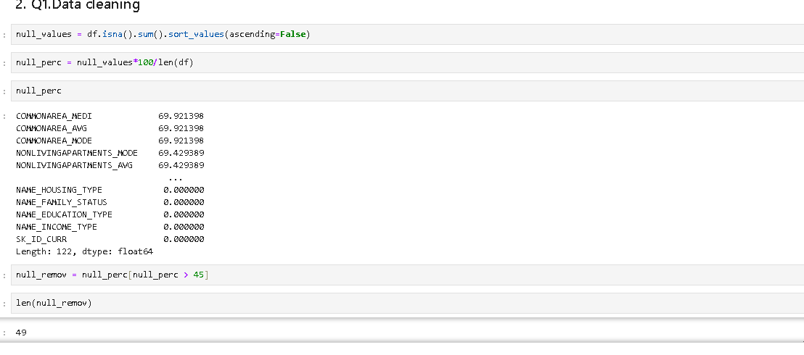
A. Identify Missing Data and Deal with it Appropriately : Identify the missing data in the dataset and decide on an appropriate method to deal with it using Excel built-in functions and features.

Slide 5
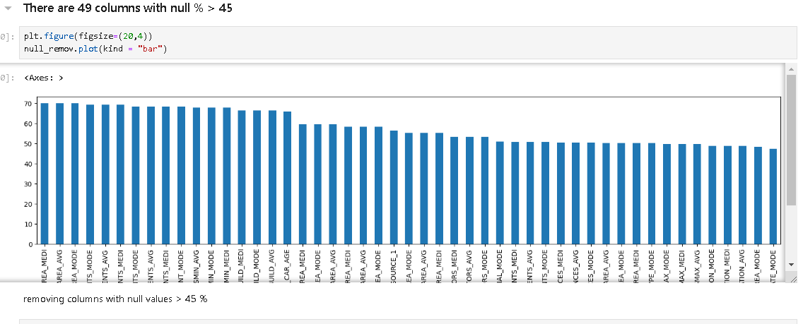
There are 49 columns with greater than 45% null values

Slide 6
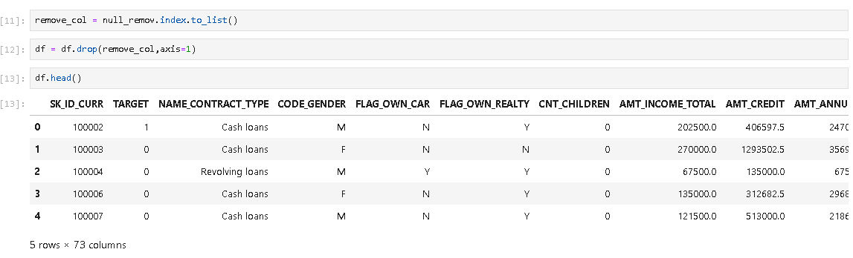
Remove all columns with null values > 45%
For full solution click on the link below:-

Slide 7
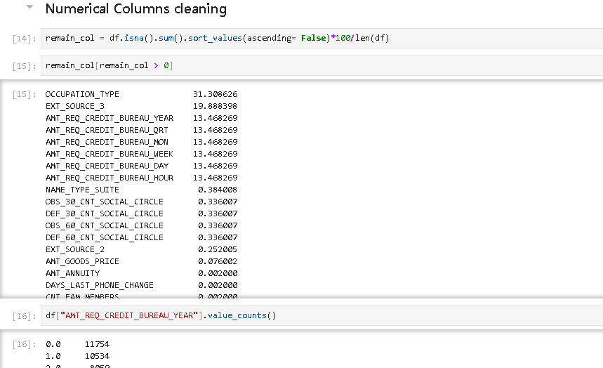
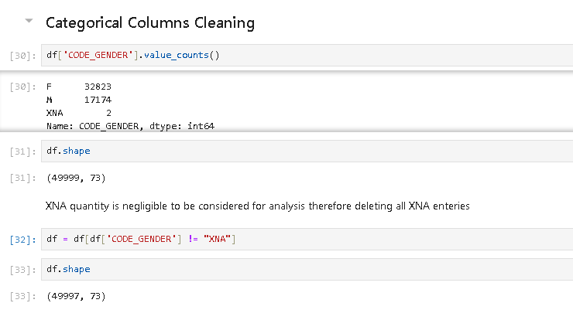
Data Cleaning 1. Numerical Data 2. Categorical Data

Slide 8
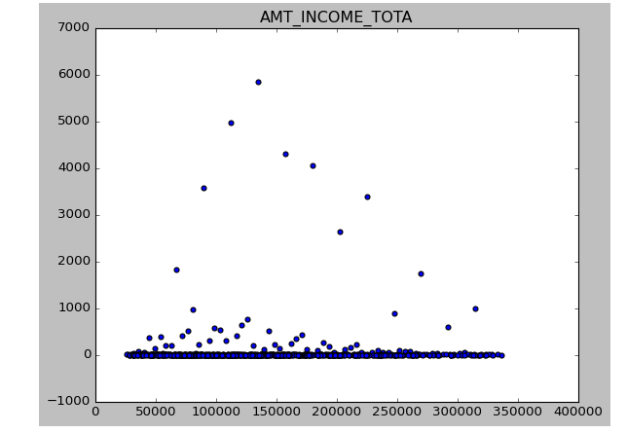
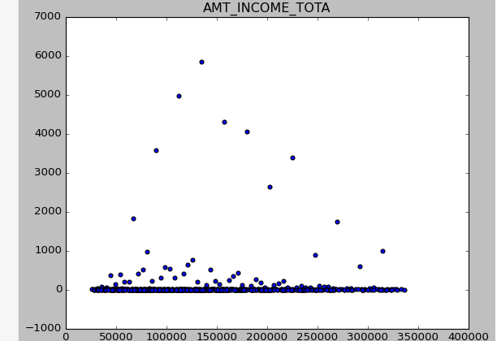
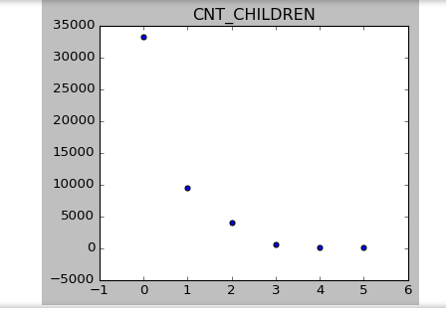
B. Identify Outliers in the Dataset

Slide 9
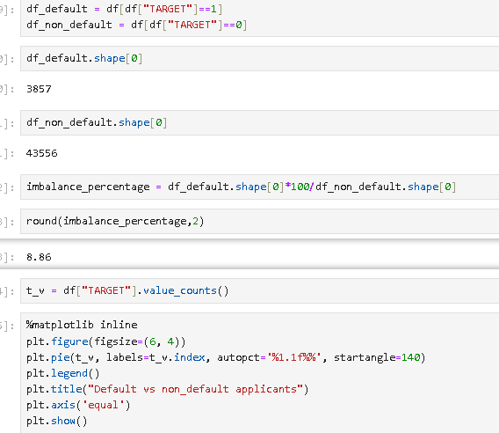
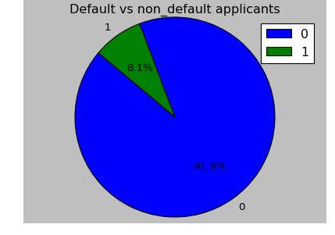
C. Analyze Data Imbalance: Determine if there is data imbalance in the loan application dataset and calculate the ratio of data imbalance using Excel functions
In Target column
1 represent default applicants
0 represents non default applicants

Slide 10
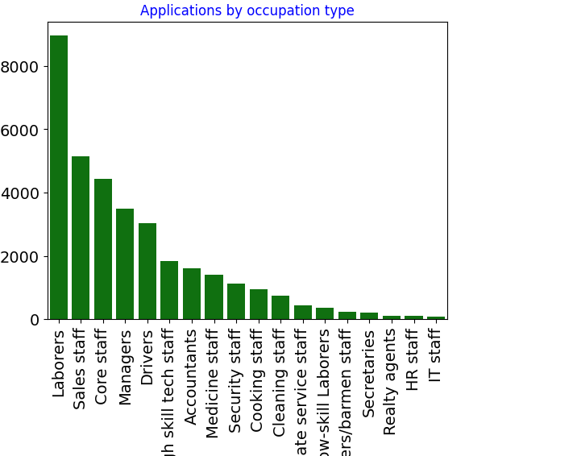
D. Perform Univariate, Segmented Univariate, and Bivariate Analysis: Perform univariate analysis to understand the distribution of individual variables, segmented univariate analysis to compare variable distributions for different scenarios, and bivariate analysis to explore relationships between variables and the target variable using Excel functions and features.
i . Qualitative Variables(Categorical data)
Applications by occupation type - We can infer that most of the applications come for Labourers, Sales Staff and Core Staff

Slide 11
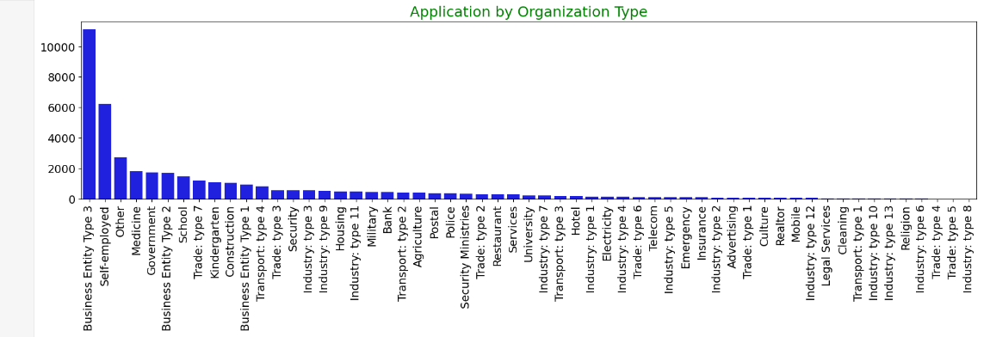
Organization Type
It is observed that majority of the applicants belong to Business Entity Type 3 an Self Employed

Slide 12
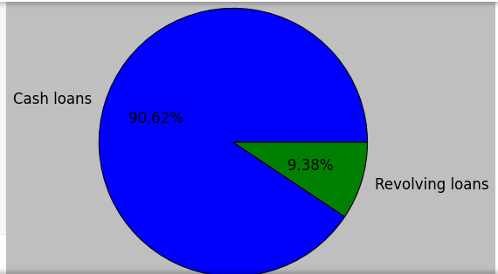
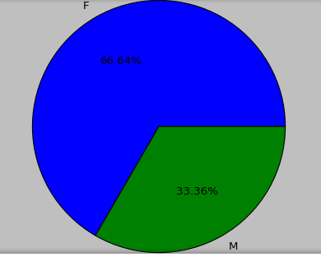
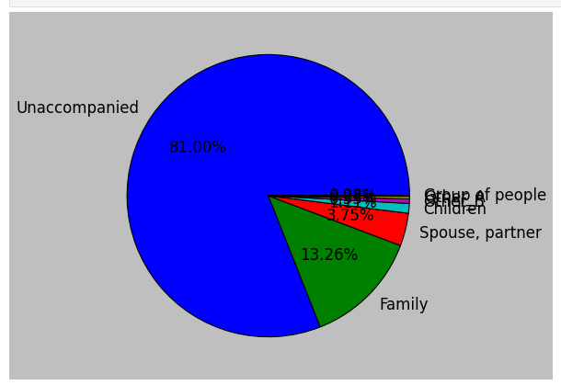
Categorical data
For Code_Gender
NAME_CONTRACT_TYPE'
NAME_TYPE_SUITE

Slide 13
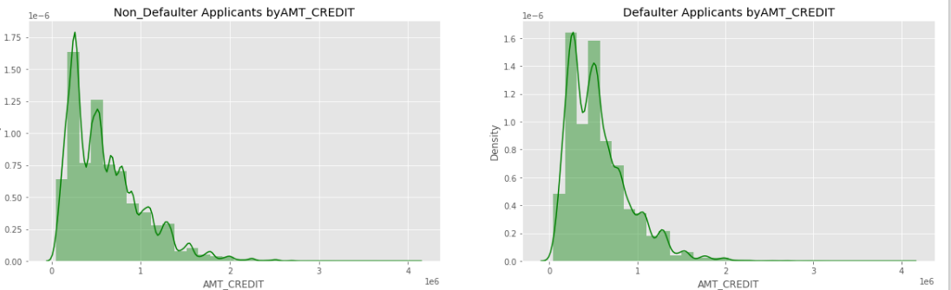
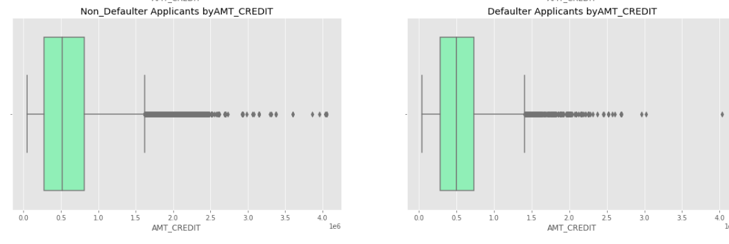
ii.Quantitative variables (Numerical data) Insights- Loan Amount doesn't seem to have any correlation with Loan defaults.

Slide 14
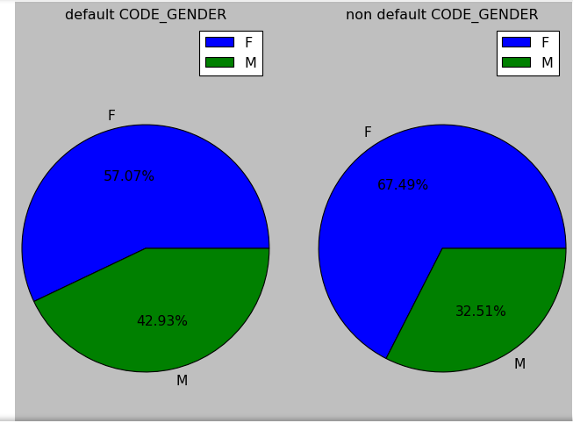
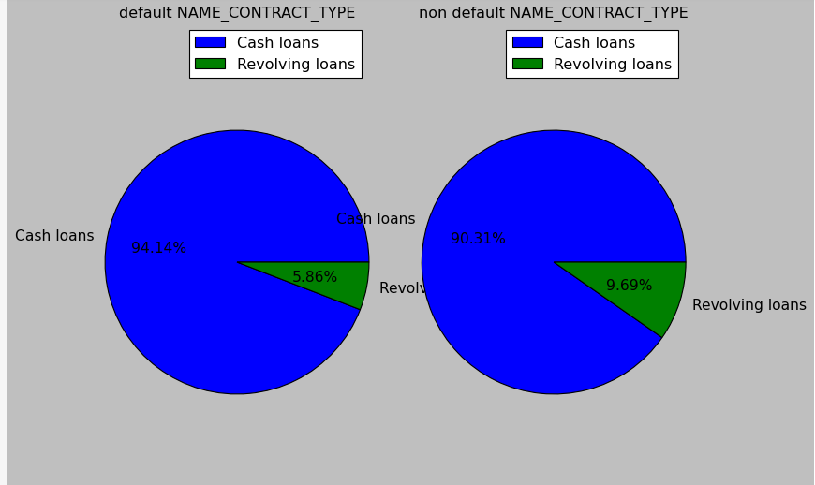
Bivariate Analysis
Cash loans are slightly more likely to be defaulted than revolving loans.

Slide 15
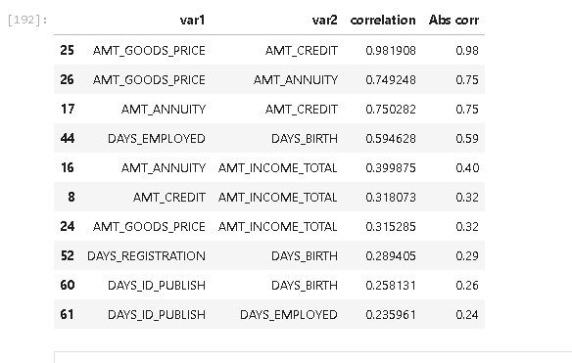
E.Identify Top Correlations for Different Scenarios : Segment the dataset based on different scenarios (e.g., clients with payment difficulties and all other cases) and identify the top correlations for each segmented data
Top 10 Correlation Segmented data
Lower the highest education of an applicant, higher the chance of loan default. This is one of the core driving factor in loan defaults.
Labourers & Sales staff are major area of concern , with maximum applicants and a significant loan default rate. Drivers also have an alarming combination of counts and default %.
Applicants on Maternity leave have a whopping 40% loan default rate. Unemployed applicants also have 35% loan defaults
Low Income range have maximum % of loan defaults. As the Income range increases, loan default probability decreases
Among different family status, married ones have the highest likelihood of loan default
Applicants with lower Annuity Amount are slightly more likely to default on a loan.

Slide 16
Thank You

